Slide 1



Slide 2
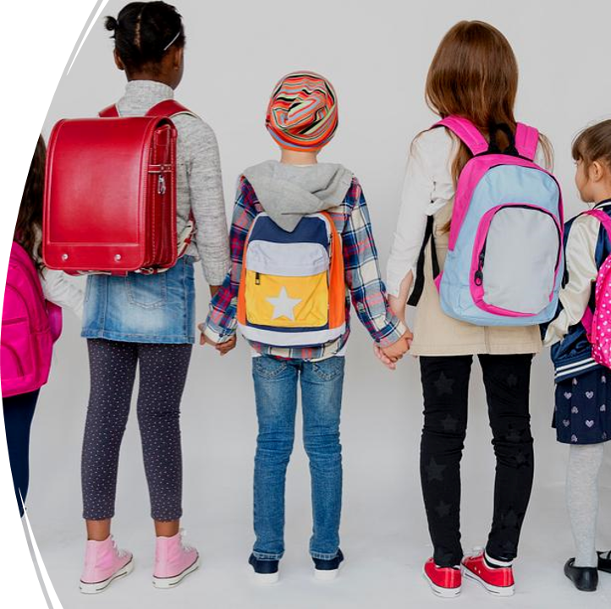
Problem
Decreased Communication
Decreased Response Times

Slide 3
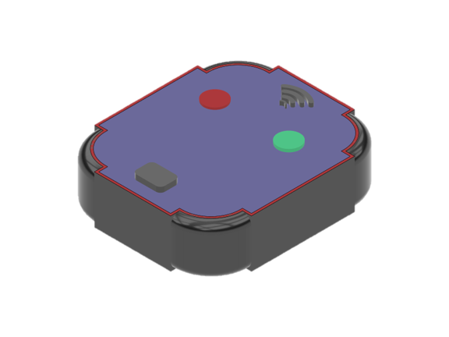
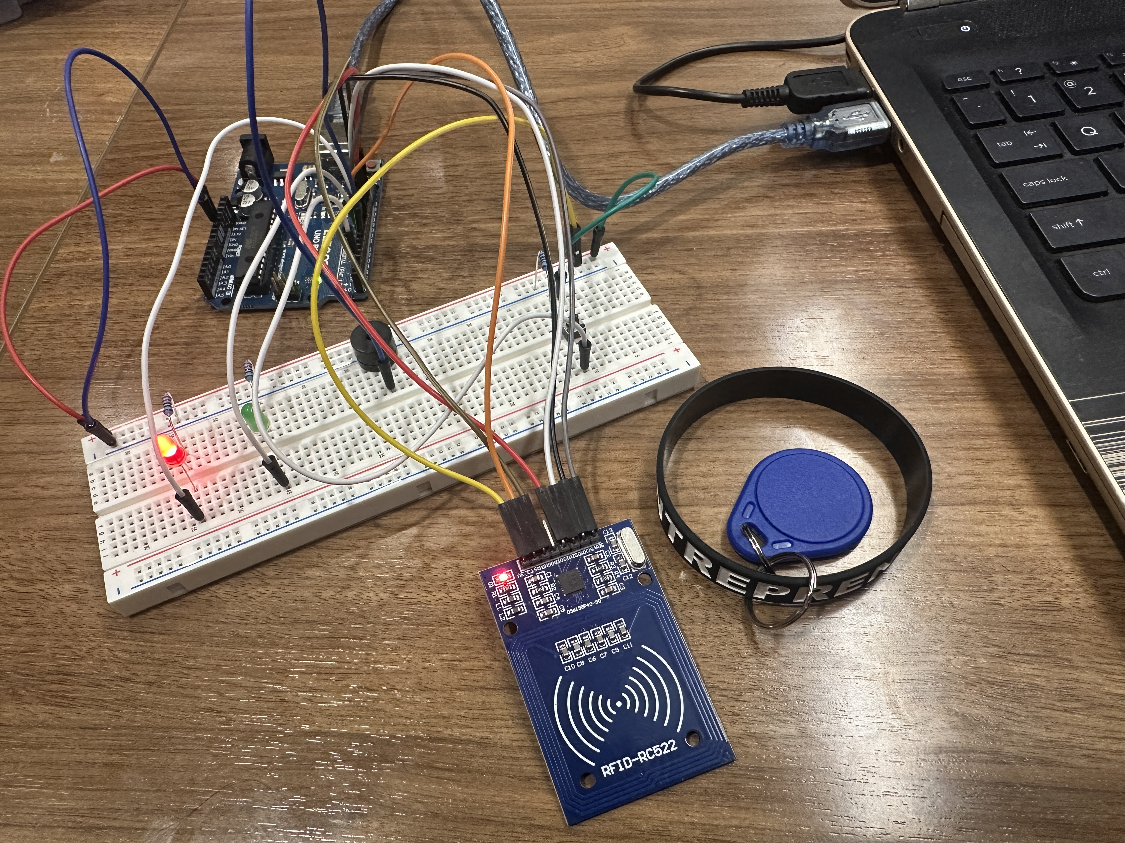
Solution: SafeBand
3D Model of Wearable Device
Proof of Concept Hardware

Slide 4
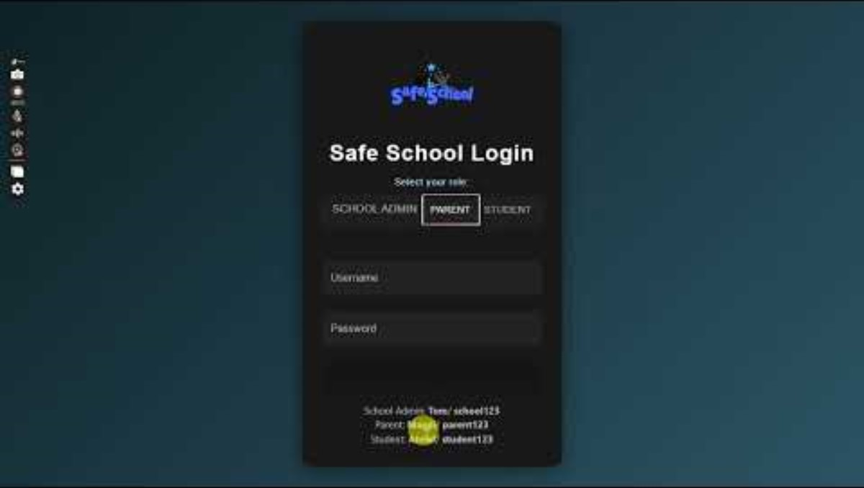
Safe School Web Application

Slide 5
Customer Segment
Superintendent / Principial of Schools
Customer Acquistion Barrier:
Budget & Less Demand

Slide 6
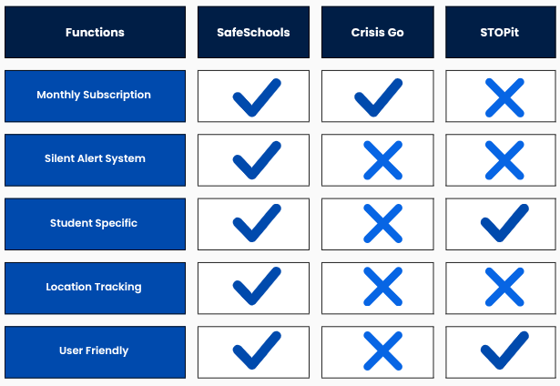
Competitor Analysis

Slide 7

Unique Selling Points (USP)
Seamless Communication
One-Tap
Response
Minimize Smart Devices
Optimize Student
Management

Slide 8
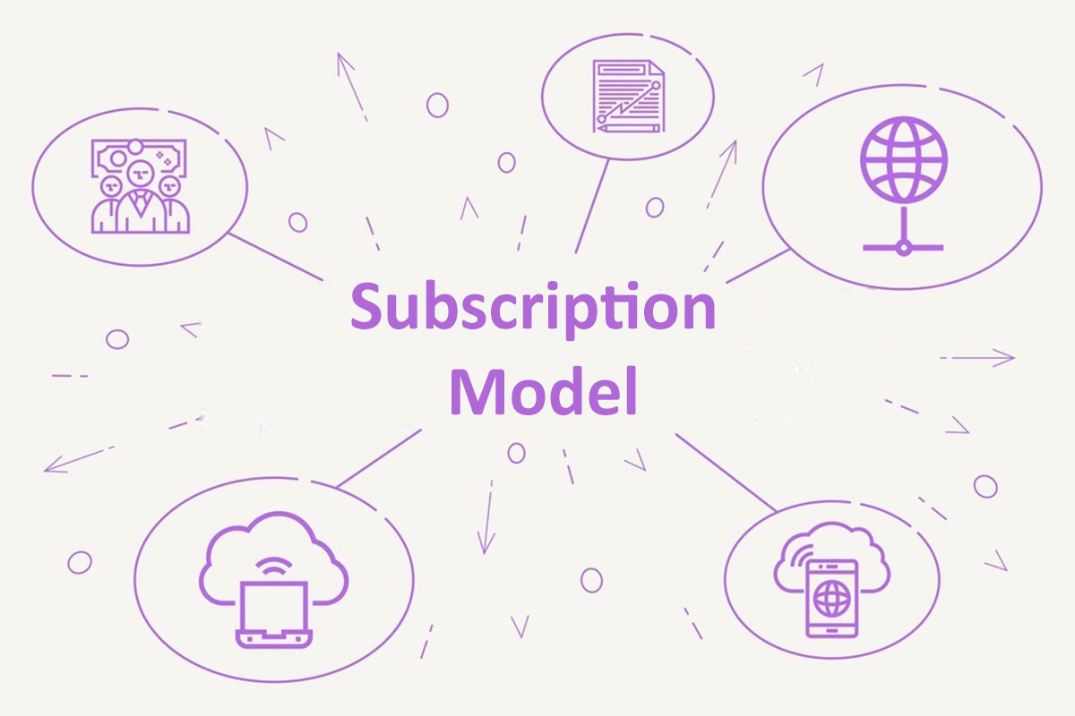
Revenue Model
Giving the wristbands at a bare minimum cost (One Time Purchase) & Charging the schools for our software interphase in Annual Subscription Based Model.
What They Get
Interactive app for easier navigation
Student Location access
Silent reporting
Student management
Digital communication without a smart device

Slide 9
Our Next Steps
01
02
Interconnecting hardware to software
Build functional prototype
03
04
05
Scale production process
Patent intellectual property
Pre-seed Funding: iLaunch, Accelerator, VC options

Slide 10
Customer Discoveries
"Is there truly an honest communication line between students, parents, and teachers?"
"I felt somewhat safe at school;
I was somewhat bullied a lot."
"Relying on humans to account and report factually is always a worry
"No, I don't know where students are, you assume they are in the building, but you don't if they are in the building
"It's somewhat hard for me to manage in the hustle and bustle!"

Slide 11
Thanks!
Do you have any questions?
Safeschool25@gmail.com
ahnaf-muizz.github.io
Please keep this slide for attribution

Slide 12

Hardware Demonstration
Website Link

Slide 13
SWOT Analysis
Strength
Weakness
Interactive seamless communication
Handy tool
Easy to adapt
School District Budget
Less Interest in Administration Level
Opportunity
Threat
Making Part of a School Merch
Building Habits and Accountability
Revolutionize Worldwide Emergency Response Service
Need to Scale The Manufacturing
Growing Global Competitors

